Slide 1
NETWORK ANALYSIS
Most companies undertake project projects which involve capital expenditure over a reasonable period of time, lasting between six months to ten years.
The projects may involve hundred of activities each of which may take a longer or shorter time to complete than previously estimated.
The management of such project is crucial if the company does not want to risk large costs that occur if deadlines are not met, or wish to make substantial savings by good planning and cost effective scheduling of the projects costs.
Traditional costing methods does not prevent in cost of project rising.
Project cost control is an extension of budgetary control methods.
Variances can be computed – Provide a reliable basis for comparison between actual costs incurred with the budgeted costs.
Management can control both the progress and costs of the project.
Unit costing methods are complementary to and not alternative to, project cost control.

Slide 2
SIX STEPS – PERT / CPM
Define the project and split the project into distinct activities and tasks.
Determine the relationships between the activities , and list all precedence relationships.
Draw a net work diagram showing the precedence relationships between the activities.
Determine the duration and cost of each activity.
Calculate the critical path and its duration for the network.
Use the network to help plan, schedule, monitor and control the project.

Slide 3
CRITICAL PATH
The critical path is the longest pathway through the network.
Any delay to activities on this pathway will delay completion of the project.
Particular attention should be paid to critical pathway and other pathways whose durations are close to the critical path duration in order to effectively control the project.
Reducing the time on critical path by allocating additional resources will allow project deadlines to be revised.
Flexibility can be obtained by identifying non critical activities and re-planning, rescheduling and reallocating resources such as manpower, machinery and finance.

Slide 4
CPM EXAMPLE
M/s Etihad company is planning to undertake following maintenance project. The company has identified five activities A to E , along with their associated duration and cost, which have to be completed within 25 weeks.
Activities Precedence Duration Direct cost (Weeks) (£)
A NONE 5 800
B None 3 420
C A 8 560
D B 6 240
E C,D 7 700
Requirement: Calculate the critical path.

Slide 5
Solution – Critical path
Steps 1, 2 and 4 already done / provided in the question.
Step 3- Drawing the net work and
Step 5 calculation of the critical path are to be done
0
A C
5 8 E E
B D 7
3 6
Note: The critical activities are A , C and E and the project duration is 20 Weeks.
1
5
5
3
13 13
4
0 00
20
20
2
3
7

Slide 6
TOTAL DIRECT COST OF THE PROJECT (All figures in £)
The total direct cost of the project is £ 2720.
£ 800+420+560+240+700 = £ 2720 .
M/s Etihad company can complete the maintenance project with in the required time of 25 weeks without the need to use additional resources.

Slide 7
COMPUTATION OF FLOAT
All activities not lying on the critical path contain total float. Total float is the time by which an activity may be delayed or extended without increasing the overall project time.
Total float = Latest time of the head event (–) Earliest time of the tail event (–) Duration of the activity.
The tail event occurs before the head event.
The total float on activity D is 13-3-6=4. That is activity D can be delayed up to 4 weeks without extending the time of the project beyond 20 weeks.

Slide 8
COMPUTATION OF FLOAT
Free float = Earliest time of the head event – Earliest time of the tail event – Duration.
Independent float = Earliest time of the head event – Latest time of the tail event – Duration.

Slide 9
USE OF DUMMY ACTIVITIES
Sometimes the precedence requirements cause problems in the drawing of a network, and dummy activities have to be incorporated.
These, dummy activities do not have a physical reality, they are given a zero (0) duration, but are only included in the diagram as a dashed line, to preserve the logic.
Lets assume Etihad company required in the maintenance project that activity D is to be preceded by both A and B activities.
The network diagram need to be adjusted by incorporating a dummy activity between node 1 and node 2.
We need to recalculate the earliest and latest event times. (In our example the critical path not changed – ACE with a duration of 20 weeks) .
However, the flexibility has been reduced as the earliest event time for node 2 is 5 instead of 3

Slide 10
Dummy activity
Steps 1, 2 and 4 already done / provided in the question.
Step 3- Drawing the net work and
Step 5 calculation of the critical path are to be done
0
A C
5 8 E E
B D 7
3 6
Note: The critical activities are A , C and E and the project duration is 20 Weeks.
1
5
5
3
13 13
4
0 00
20
20
2
5
7

Slide 11
PROJECT COST CONTROL
In order to monitor and control the project the network diagram is used to plan and schedule timing of costs – budgeted cost.
The stages in budgeting process are:
Identify all costs associated with each of the activities . Add them together to one estimated cost for each activity.
Calculate from the estimated cost per activity the estimated cost per time period.
The earliest and latest start times should be used, to determine the costs during each time period in order to complete the project within the target period.
For simplicity we assume the cost of an activity is incurred uniformally over the duration of the activity.

Slide 12
CALCULATION OF DIRECT COST PER WEEK FOR EACH ACTIVITY.
Activity Direct Cost Duration Direct cost
(weeks) per week (£)
A 800 5 160
B 420 3 140
C 560 8 70
D 240 6 40
E 700 7 100

Slide 13
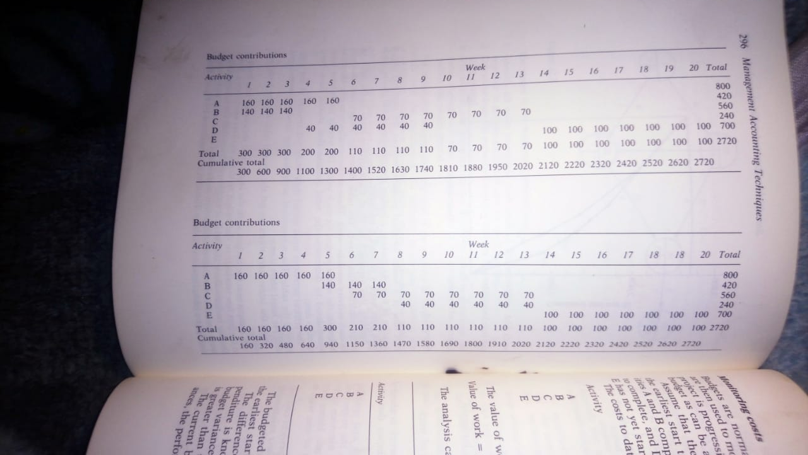
BUDGET CONTRIBUTION- TABLE

Slide 14
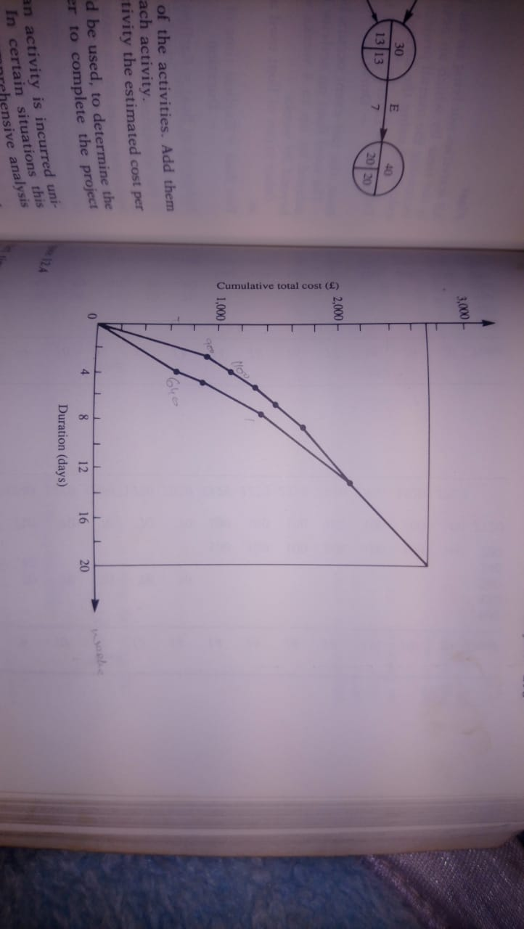
BUDGET COMPARISION – EARLIEST START TIME VS LATEST START TIME

Slide 15
EXPLATION OF TABLE AND GRAPH
Activity A has the earliest start time of zero (0) and duration of 5 weeks, therefore budget contribution from A will be £ 160 for each of the first 5 weeks.
Activity D has an earliest start time of 3 weeks (Original example without dummy) and duration of 6 weeks making a budget contribution of £ 40 during each week from week 4 to week 9 inclusive.
Applying this technique to all of the activities leads to the table of budget contribution shown in the previous slides.
The table shows the budget contribution for each activity week by week. These are accumulated to give the total budget for the entire project for each week.
The weekly totals have been accumulated to determine the total amount that should have been spent to date.

Slide 16
The critical activities must spend their budgeted amount at the time given in the above table (previous slides).
The non critical activities may however be delayed until the latest start time.
Revised table for the budgeted cost was prepared by using latest start time.
The two budgets (tables) shows earliest and latest times that the funds can be spent.
Management can choose any budget that falls within these two tables.

Slide 17
MONITORING COSTS
Budgets are normally prepared before the project is undertaken .
Budgets are used to monitor and control the project costs to ensure that the project is progressing as far as possible on schedule and as close to the budget as can be achieved.
Assume M/s Etihad company maintenance project, working on the earliest start times, has just completed the Tenth (10th ) week with activities A and B completed. C being ahead of schedule with only two (2) weeks to complete, and D being behind the schedule with one more week needed, E has not yet started.

Slide 18
ACTUAL COSTS FOR EACH ACTIVITY
ACTIVITY DIRECT COST (£)
A 1000
B 370
C 400
D 250
E 0
TOTAL 2020

Slide 19
VALUE OF WORK COMPLETED
Value of work completed = Total budget per activity x percentage of work completed.
Activity Total cost Percentage Value of work
(£) Completed completed (£)
A 800 100 800
B 420 100 420
C 560 75 420
D 240 83 200
E 700 0 0
TOTAL £ 2720 £ 1840

Slide 20
Budgeted cost to date £ 1810 (Week 10th end – see earlier slide-table)
The difference between the cost incurred and budgeted expenditure is known as current budget variance.
Current budget variance is £ 2020-1810= £210 showing that the incurred cost is greater than the budgeted cost to date. (Please see cumulative total at the end of week 10 in the above table).
The current budget variance can be split into two component variances, the performance variance and efficiency variance.
Performance variance= Budget value of work done – budgeted expenditure.
£ 1840-1810=£30
Efficiency variance = Incurred cost – budget value of work
£2020-1840=£180

Slide 21
Positive performance variance shows that the work is ahead of schedule whereas the positive efficiency variance shows that overspending has occurred.
As C activity requires 2 more weeks and D activity one more week and assuming E will still take the estimated time of 7 weeks, the project will require 9 weeks to complete. A total project time of nineteen weeks.
This is a saving of 1 week one week on the estimated project time.
Hence there is a slight overrun on the cost , but potential saving of one week in the total time.

Slide 22
PROJECTING CRASHING WITH CPM
Assume Etihad Company have to complete the maintenance project with in 15 weeks instead of 25 week.
The critical path is 20 weeks, hence the deadline cannot be met unless more resources can be obtained to shorten the times of some of the activities.
This shortening of activities is called crashing.
The introduction of new resources will involve extra expenditure and manager needs to determine which activities to crash in order to achieve the minimum extra cost.

Slide 23
PROJECT CRASHING PROCEDURE
Determine the critical path.
Calculate the crash cost per unit time period for each activity in the net work where :
Crash cost / unit time period = (Crash Cost – normal cost)
(Normal time – Crash time)
Identify the activity on the critical path with the smallest crash cost / unit time period. Crash this activity as much as possible until
Another path becomes critical as well or
The deadline has been met or
No more crashing of this activity can be done.
If condition 3(II) is met the task has been completed. If condition 3(I) is met return to step 3 crashing on both critical paths simultaneously. If condition 3(III) is met return to step 3 ignoring any activities previously crashed.

Slide 24
EXAMPLE – CRASHING OF THE PROJECT
THE FOLLOWING INFORMATION OBTAINED FOR THE ETIHAD COMPANY’S PROJECT.
Activity Time Cost
weeks) (£)
Normal Crash Normal Crash
A 5 3 800 900
B 3 2 420 500
C 8 5 560 740
D 6 3 240 540
E 7 4 700 910

Slide 25
CALCULATIONS – CRASHING OF PROJECT
THE CRASH TIMES PER WEEK ARE
A (900-800) / ( 5-3) = 50
B (500-420) / ( 3-2) = 80
C (740-560) / ( 8-5) = 60
D (540-240) / ( 6-3) =100
E (910-700) / ( 7-4) =70

Slide 26
CRASHING OF ACTIVITIES - PROJECT
Activity Cut Project Duration Cost Cumulative Cost
(Weeks) (£) (£)
None 20 0 2720
Activity A by 2 18 100 2820
ACE is still critical
Activity C by 2 16 120 2940
ACE and BDE are now critical. It is a choice between C and B at £ 60 + £80 = £ 140 or E or £ 70
Activity E by 1 15 70 3010.
The target of 15 weeks has been achieved at a total additional cost of £3010 - £2720 = £ 290.

Slide 27
THE PERT APPROACH
THE CPM METHOD ASSUMES THAT THE ACTIVITY DURATIONS ARE CERTAIN.
PERT APPROACH WAS DEVELOPED TO DEAL WITH ACTIVITIES WHERE THERE IS UNCERTAINITY IN THE DURATIONS OF THE ACTIVITY.
FOR A PERT ACTIVITY THREE ESTIMATES OF DURATION ARE REQUIRED.
Optimistic time (a) or ((o) = the shortest time the activity will take if every things go well
Most likely time (m) = the model time, i.e., the time that most would estimate.
Pessimistic time (b) or (p) = The longest time the activity will take assuming everything does not go well.
PERT ASSUMES THAT THESE TIME ESTIMATES FOLLOW BETA PROBABLITY DISTRIBUTION GIVING THE EXPECTED ACTIVITY TIME AS:
t= (a +4m +b) or t = (o + 4m + p)
6 6
AND STANDARD DEVIATION AS :
SD = (b-a) or SD = (p-o)
6 6

Slide 28
THE PERT APPROACH
The t (expected activity time) is used to find the expected project duration, and the activity standard deviations can be used to examine the likely variability in the expected project duration.
PERT example – applying on Etihad company case.
Activity Optimistic Most likely Pessimistic
(a) (m) (b)
A 2 5 8
B 2 2.5 6
C 4 7 16
D 5 6 7
E 1 8 9
Requirements: Calculate the expected times, the standard deviation and the variance (standard deviation squared) of the activities.

Slide 29
Activity Expected time Standard Deviation Variance
(t) (SD) (v)
A 5 1 1
B 3 0.667 0.444
C 8 2 4
D 6 0.333 0.111
E 7 1.333 1.778
Note:
The expected time durations are the same as it was in the CPM example and hence the critical path is ACE with duration 20weeks as before.
The variance for the project duration is the same as the variance of the critical path which is the sum of the variance of the critical activities.
Project variance = 1+4+1.778 = 6.778 or the project Standard deviation = 2.60 weeks.

Slide 30
THE PERT APPROACH
PERT ASSUMES THAT THE PROJECT TIMES ARE INDEPENDENT OF EACH OTHER AND THAT THE TOTAL PROJECT TIME FOLLOWS A NORMAL DISTRIBUTION
HENCE THE PROBABILITY OF THE PROJECT TIME EXCEEDING CAN BE DETERMINED USING NORMAL TABLES:
Z = (25 -20) = 1.92
2.6
FROM THE NORMAL DISTRIBUTION TABLES, TABLE AREA = 0.4726
THEREFORE TAIL AREA = 0.5 – 0.4726 = 0.0274
JUST UNDER 3 % CHANCE THAT THE PROJECT WILL EXCEED THE DEADLINE.

Slide 31
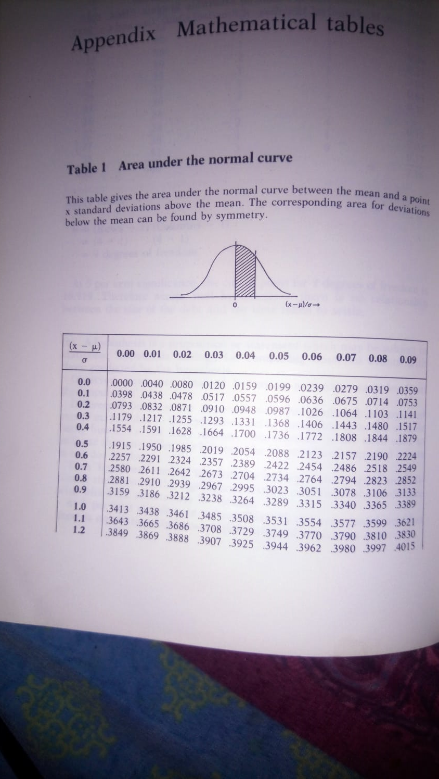
NORMAL DISTRIBUTION

Slide 32
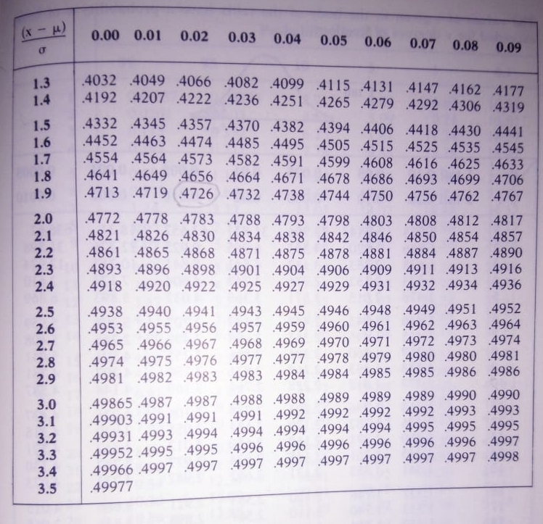
NORMAL DISTRIBUTION

Slide 33
THE PERT APPROACH
A 95 % CONFIDENCE INTERVAL FOR THE PROJECT TIME COULD ALSO BE CALCULATED.
95% CI = Mean +- 1.96 x Standard Deviation
= 20 +- 1.96 x 2.6 weeks
= 20 +- 5.1 weeks
THE PROBABILITY IS 0.95 OR 95% THAT THE TIME ESTIMATES WOULD HAVE COME FROM A PROJECT WHOSE DURTION IS BETWEEN 14.9 AND 25.1 WEEKS.

